Slide 1

Notes:
This template is for educational, non-commercial purposes only. For more free game templates like this one, visit https://www.taysteachingtoolkit.com

Slide 2

CHOOSE A LETTER & ANSWER A QUESTION.

Slide 3
IF YOU’RE RIGHT, YOU CAN PLAY A CARD GAME FOR POINTS!

Slide 4


I WILL SHOW YOU A CARD.
+4 POINTS
+4 POINTS

Slide 5
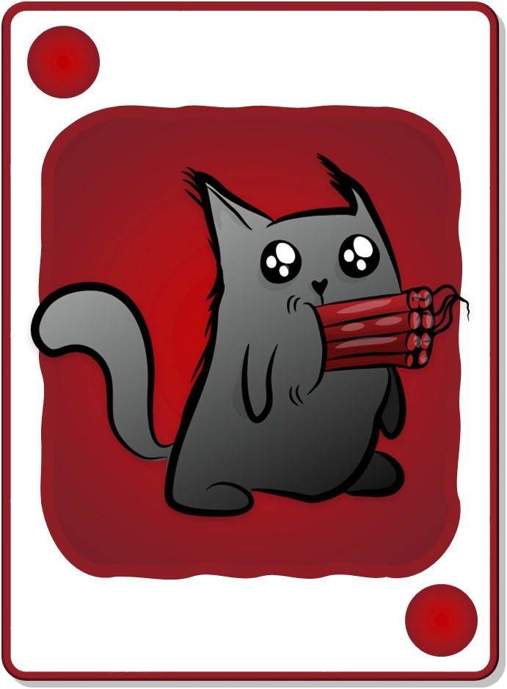

KEEP THE POINTS ON THE CARD OR DRAW AGAIN FOR MORE POINTS!
+2 POINTS
+4 POINTS
Take 6 points
Take 4 points
Draw again
+4 POINTS
+2 POINTS

Slide 6

BEWARE! IF YOU FIND A BOMB, YOU GET 0 POINTS & THE GAME IS OVER.
+2 POINTS
BOMB!
Take 6 points
Draw again
+2 POINTS
BOMB!
Notes:
game over = their turn is over and they get no points for their turn

Slide 7




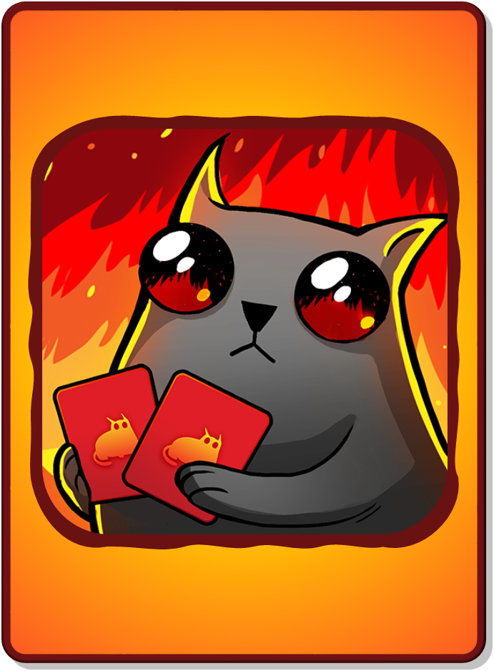

DECK CARDS
+1 POINT
+2 POINTS
+3 POINTS
+4 POINTS
+5 POINTS
BOMB!
NUCLEAR!
+1 POINT
+2 POINTS
+3 POINTS
+4 POINTS
+5 POINTS
BOMB!
NUCLEAR!
All teams lose all points!
LOSE ALL POINTS!
CHANGE POINTS!
Only your team loses all their points!
RARE CARDS
(not in deck)
LSOE ALL POINTS!
CHANGE POINTS!
Notes:
“Rare cards” cannot be found in the decks where students accumulate points. They’re a separate reward event (see reward slides for details).

Slide 8

A
B
C
D
E
CHOOSE A LETTER
F
G
H
I
J
K
L
M
N
O
P
Q
R
S
T
U
V
W
X
Y
Z
Notes:
A student/team chooses a letter.
Click the letter they choose to go to the corresponding question slide.

Slide 9





INSTRUCTIONS OR QUESTION GOES HERE
Additional text or pictures go here
ANSWER GOES HERE
Notes:
Click the spacebar to make the ANSWER appear.
The blank space in the middle is for any extra text/images you need.
Click the green button to go to the reward slide.
Click the red button to go back to the question-choosing slide.
Background wood texture by vector.satrian on https://www.vecteezy.com

Slide 10
INSTRUCTIONS OR QUESTION GOES HERE
Additional text or pictures go here
ANSWER GOES HERE
Notes:
Click the spacebar to make the ANSWER appear.
The blank space in the middle is for any extra text/images you need.
Click the green button to go to the reward slide.
Click the red button to go back to the question-choosing slide.
Background wood texture by vector.satrian on https://www.vecteezy.com

Slide 11
INSTRUCTIONS OR QUESTION GOES HERE
Additional text or pictures go here
ANSWER GOES HERE
Notes:
Click the spacebar to make the ANSWER appear.
The blank space in the middle is for any extra text/images you need.
Click the green button to go to the reward slide.
Click the red button to go back to the question-choosing slide.
Background wood texture by vector.satrian on https://www.vecteezy.com

Slide 12
INSTRUCTIONS OR QUESTION GOES HERE
Additional text or pictures go here
ANSWER GOES HERE
Notes:
Click the spacebar to make the ANSWER appear.
The blank space in the middle is for any extra text/images you need.
Click the green button to go to the reward slide.
Click the red button to go back to the question-choosing slide.
Background wood texture by vector.satrian on https://www.vecteezy.com

Slide 13
INSTRUCTIONS OR QUESTION GOES HERE
Additional text or pictures go here
ANSWER GOES HERE
Notes:
Click the spacebar to make the ANSWER appear.
The blank space in the middle is for any extra text/images you need.
Click the green button to go to the reward slide.
Click the red button to go back to the question-choosing slide.
Background wood texture by vector.satrian on https://www.vecteezy.com

Slide 14
INSTRUCTIONS OR QUESTION GOES HERE
Additional text or pictures go here
ANSWER GOES HERE
Notes:
Click the spacebar to make the ANSWER appear.
The blank space in the middle is for any extra text/images you need.
Click the green button to go to the reward slide.
Click the red button to go back to the question-choosing slide.
Background wood texture by vector.satrian on https://www.vecteezy.com

Slide 15
INSTRUCTIONS OR QUESTION GOES HERE
Additional text or pictures go here
ANSWER GOES HERE
Notes:
Click the spacebar to make the ANSWER appear.
The blank space in the middle is for any extra text/images you need.
Click the green button to go to the reward slide.
Click the red button to go back to the question-choosing slide.
Background wood texture by vector.satrian on https://www.vecteezy.com

Slide 16
INSTRUCTIONS OR QUESTION GOES HERE
Additional text or pictures go here
ANSWER GOES HERE
Notes:
Click the spacebar to make the ANSWER appear.
The blank space in the middle is for any extra text/images you need.
Click the green button to go to the reward slide.
Click the red button to go back to the question-choosing slide.
Background wood texture by vector.satrian on https://www.vecteezy.com

Slide 17
INSTRUCTIONS OR QUESTION GOES HERE
Additional text or pictures go here
ANSWER GOES HERE
Notes:
Click the spacebar to make the ANSWER appear.
The blank space in the middle is for any extra text/images you need.
Click the green button to go to the reward slide.
Click the red button to go back to the question-choosing slide.
Background wood texture by vector.satrian on https://www.vecteezy.com

Slide 18
INSTRUCTIONS OR QUESTION GOES HERE
Additional text or pictures go here
ANSWER GOES HERE
Notes:
Click the spacebar to make the ANSWER appear.
The blank space in the middle is for any extra text/images you need.
Click the green button to go to the reward slide.
Click the red button to go back to the question-choosing slide.
Background wood texture by vector.satrian on https://www.vecteezy.com

Slide 19
INSTRUCTIONS OR QUESTION GOES HERE
Additional text or pictures go here
ANSWER GOES HERE
Notes:
Click the spacebar to make the ANSWER appear.
The blank space in the middle is for any extra text/images you need.
Click the green button to go to the reward slide.
Click the red button to go back to the question-choosing slide.
Background wood texture by vector.satrian on https://www.vecteezy.com

Slide 20
INSTRUCTIONS OR QUESTION GOES HERE
Additional text or pictures go here
ANSWER GOES HERE
Notes:
Click the spacebar to make the ANSWER appear.
The blank space in the middle is for any extra text/images you need.
Click the green button to go to the reward slide.
Click the red button to go back to the question-choosing slide.
Background wood texture by vector.satrian on https://www.vecteezy.com

Slide 21
INSTRUCTIONS OR QUESTION GOES HERE
Additional text or pictures go here
ANSWER GOES HERE
Notes:
Click the spacebar to make the ANSWER appear.
The blank space in the middle is for any extra text/images you need.
Click the green button to go to the reward slide.
Click the red button to go back to the question-choosing slide.
Background wood texture by vector.satrian on https://www.vecteezy.com

Slide 22
INSTRUCTIONS OR QUESTION GOES HERE
Additional text or pictures go here
ANSWER GOES HERE
Notes:
Click the spacebar to make the ANSWER appear.
The blank space in the middle is for any extra text/images you need.
Click the green button to go to the reward slide.
Click the red button to go back to the question-choosing slide.
Background wood texture by vector.satrian on https://www.vecteezy.com

Slide 23
INSTRUCTIONS OR QUESTION GOES HERE
Additional text or pictures go here
ANSWER GOES HERE
Notes:
Click the spacebar to make the ANSWER appear.
The blank space in the middle is for any extra text/images you need.
Click the green button to go to the reward slide.
Click the red button to go back to the question-choosing slide.
Background wood texture by vector.satrian on https://www.vecteezy.com

Slide 24
INSTRUCTIONS OR QUESTION GOES HERE
Additional text or pictures go here
ANSWER GOES HERE
Notes:
Click the spacebar to make the ANSWER appear.
The blank space in the middle is for any extra text/images you need.
Click the green button to go to the reward slide.
Click the red button to go back to the question-choosing slide.
Background wood texture by vector.satrian on https://www.vecteezy.com

Slide 25
INSTRUCTIONS OR QUESTION GOES HERE
Additional text or pictures go here
ANSWER GOES HERE
Notes:
Click the spacebar to make the ANSWER appear.
The blank space in the middle is for any extra text/images you need.
Click the green button to go to the reward slide.
Click the red button to go back to the question-choosing slide.
Background wood texture by vector.satrian on https://www.vecteezy.com

Slide 26
INSTRUCTIONS OR QUESTION GOES HERE
Additional text or pictures go here
ANSWER GOES HERE
Notes:
Click the spacebar to make the ANSWER appear.
The blank space in the middle is for any extra text/images you need.
Click the green button to go to the reward slide.
Click the red button to go back to the question-choosing slide.
Background wood texture by vector.satrian on https://www.vecteezy.com

Slide 27
INSTRUCTIONS OR QUESTION GOES HERE
Additional text or pictures go here
ANSWER GOES HERE
Notes:
Click the spacebar to make the ANSWER appear.
The blank space in the middle is for any extra text/images you need.
Click the green button to go to the reward slide.
Click the red button to go back to the question-choosing slide.
Background wood texture by vector.satrian on https://www.vecteezy.com

Slide 28
INSTRUCTIONS OR QUESTION GOES HERE
Additional text or pictures go here
ANSWER GOES HERE
Notes:
Click the spacebar to make the ANSWER appear.
The blank space in the middle is for any extra text/images you need.
Click the green button to go to the reward slide.
Click the red button to go back to the question-choosing slide.
Background wood texture by vector.satrian on https://www.vecteezy.com

Slide 29
INSTRUCTIONS OR QUESTION GOES HERE
Additional text or pictures go here
ANSWER GOES HERE
Notes:
Click the spacebar to make the ANSWER appear.
The blank space in the middle is for any extra text/images you need.
Click the green button to go to the reward slide.
Click the red button to go back to the question-choosing slide.
Background wood texture by vector.satrian on https://www.vecteezy.com

Slide 30
INSTRUCTIONS OR QUESTION GOES HERE
Additional text or pictures go here
ANSWER GOES HERE
Notes:
Click the spacebar to make the ANSWER appear.
The blank space in the middle is for any extra text/images you need.
Click the green button to go to the reward slide.
Click the red button to go back to the question-choosing slide.
Background wood texture by vector.satrian on https://www.vecteezy.com

Slide 31
INSTRUCTIONS OR QUESTION GOES HERE
Additional text or pictures go here
ANSWER GOES HERE
Notes:
Click the spacebar to make the ANSWER appear.
The blank space in the middle is for any extra text/images you need.
Click the green button to go to the reward slide.
Click the red button to go back to the question-choosing slide.
Background wood texture by vector.satrian on https://www.vecteezy.com

Slide 32
INSTRUCTIONS OR QUESTION GOES HERE
Additional text or pictures go here
ANSWER GOES HERE
Notes:
Click the spacebar to make the ANSWER appear.
The blank space in the middle is for any extra text/images you need.
Click the green button to go to the reward slide.
Click the red button to go back to the question-choosing slide.
Background wood texture by vector.satrian on https://www.vecteezy.com

Slide 33
INSTRUCTIONS OR QUESTION GOES HERE
Additional text or pictures go here
ANSWER GOES HERE
Notes:
Click the spacebar to make the ANSWER appear.
The blank space in the middle is for any extra text/images you need.
Click the green button to go to the reward slide.
Click the red button to go back to the question-choosing slide.
Background wood texture by vector.satrian on https://www.vecteezy.com

Slide 34
INSTRUCTIONS OR QUESTION GOES HERE
Additional text or pictures go here
ANSWER GOES HERE
Notes:
Click the spacebar to make the ANSWER appear.
The blank space in the middle is for any extra text/images you need.
Click the green button to go to the reward slide.
Click the red button to go back to the question-choosing slide.
Background wood texture by vector.satrian on https://www.vecteezy.com

Slide 35

+4 POINTS
+1 POINT
BOMB!
+3 POINTS
Total Points:
0
3
7
8
+3 POINTS
+1 POINT
+4 POINTS
BOMB!
Notes:
Press the spacebar to reveal the first card.
Ask the student/team if they want to take the total points they have so far or draw again to possibly add more points.
I usually have my students say “keep going” (draw again) or “stop” (take the points they’ve accumulated).
Repeat this process until they either decide to take their accumulated points or reach a Bomb or Nuclear card.
Click the ABC Cat icon in the right-hand corner to go back the question-choosing slide.
Background wood texture by vector.satrian on https://www.vecteezy.com

Slide 36
NUCLEAR!
+2 POINTS
+1 POINT
+1 POINT
+3 POINTS
Total Points:
0
3
4
5
7
+3 POINTS
+1 POINT
+1 POINT
NUCLEAR!
+2 POINTS
Notes:
Press the spacebar to reveal the first card.
Ask the student/team if they want to take the total points they have so far or draw again to possibly add more points.
I usually have my students say “keep going” (draw again) or “stop” (take the points they’ve accumulated).
Repeat this process until they either decide to take their accumulated points or reach a Bomb or Nuclear card.
Click the ABC Cat icon in the right-hand corner to go back the question-choosing slide.
Background wood texture by vector.satrian on https://www.vecteezy.com

Slide 37
+2 POINTS
BOMB!
+3 POINTS
Total Points:
0
3
5
+3 POINTS
+2 POINTS
BOMB!
Notes:
Press the spacebar to reveal the first card.
Ask the student/team if they want to take the total points they have so far or draw again to possibly add more points.
I usually have my students say “keep going” (draw again) or “stop” (take the points they’ve accumulated).
Repeat this process until they either decide to take their accumulated points or reach a Bomb or Nuclear card.
Click the ABC Cat icon in the right-hand corner to go back the question-choosing slide.
Background wood texture by vector.satrian on https://www.vecteezy.com

Slide 38


CHANGE POINTS!
YOU FOUND A RARE CARD!
Reveal it or get 5 points?
CHANGE POINTS!
Notes:
The student/team has a choice: They can either get 5 points or take a chance and reveal the rare card, from which they will either lose all their points or get to change points with another team.
Press the spacebar to reveal the card, if they choose that option.
Click the ABC Cat icon in the right-hand corner to go back the question-choosing slide.
Background wood texture by vector.satrian on https://www.vecteezy.com

Slide 39
+2 POINTS
+1 POINT
+1 POINT
+1 POINT
+5 POINTS
BOMB!
Total Points:
10
0
1
6
7
9
+5 POINTS
+1 POINT
+1 POINT
+1 POINT
+2 POINTS
BOMB!
Notes:
Press the spacebar to reveal the first card.
Ask the student/team if they want to take the total points they have so far or draw again to possibly add more points.
I usually have my students say “keep going” (draw again) or “stop” (take the points they’ve accumulated).
Repeat this process until they either decide to take their accumulated points or reach a Bomb or Nuclear card.
Click the ABC Cat icon in the right-hand corner to go back the question-choosing slide.
Background wood texture by vector.satrian on https://www.vecteezy.com

Slide 40
NUCLEAR!
+2 POINTS
+2 POINTS
+5 POINTS
+3 POINTS
Total Points:
12
0
2
7
9
+5 POINTS
+3 POINTS
NUCLEAR!
+2 POINTS
+2 POINTS
Notes:
Press the spacebar to reveal the first card.
Ask the student/team if they want to take the total points they have so far or draw again to possibly add more points.
I usually have my students say “keep going” (draw again) or “stop” (take the points they’ve accumulated).
Repeat this process until they either decide to take their accumulated points or reach a Bomb or Nuclear card.
Click the ABC Cat icon in the right-hand corner to go back the question-choosing slide.
Background wood texture by vector.satrian on https://www.vecteezy.com

Slide 41
+2 POINTS
+2 POINTS
+2 POINTS
+2 POINTS
+1 POINT
BOMB!
+3 POINTS
Total Points:
12
0
2
4
6
7
9
+3 POINTS
+1 POINT
+2 POINTS
+2 POINTS
+2 POINTS
+2 POINTS
BOMB!
Notes:
Press the spacebar to reveal the first card.
Ask the student/team if they want to take the total points they have so far or draw again to possibly add more points.
I usually have my students say “keep going” (draw again) or “stop” (take the points they’ve accumulated).
Repeat this process until they either decide to take their accumulated points or reach a Bomb or Nuclear card.
Click the ABC Cat icon in the right-hand corner to go back the question-choosing slide.
Background wood texture by vector.satrian on https://www.vecteezy.com

Slide 42
+4 POINTS
BOMB!
Total Points:
0
4
+4 POINTS
BOMB!
Notes:
Press the spacebar to reveal the first card.
Ask the student/team if they want to take the total points they have so far or draw again to possibly add more points.
I usually have my students say “keep going” (draw again) or “stop” (take the points they’ve accumulated).
Repeat this process until they either decide to take their accumulated points or reach a Bomb or Nuclear card.
Click the ABC Cat icon in the right-hand corner to go back the question-choosing slide.
Background wood texture by vector.satrian on https://www.vecteezy.com

Slide 43
LOSE ALL POINTS!
YOU FOUND A RARE CARD!
Reveal it or get 5 points?
LSOE ALL POINTS!
Notes:
The student/team has a choice: They can either get 5 points or take a chance and reveal the rare card, from which they will either lose all their points or get to change points with another team.
Press the spacebar to reveal the card, if they choose that option.
Click the ABC Cat icon in the right-hand corner to go back the question-choosing slide.
Background wood texture by vector.satrian on https://www.vecteezy.com

Slide 44
+4 POINTS
BOMB!
+3 POINTS
+3 POINTS
Total Points:
10
0
3
7
+3 POINTS
+3 POINTS
+4 POINTS
BOMB!
Notes:
Press the spacebar to reveal the first card.
Ask the student/team if they want to take the total points they have so far or draw again to possibly add more points.
I usually have my students say “keep going” (draw again) or “stop” (take the points they’ve accumulated).
Repeat this process until they either decide to take their accumulated points or reach a Bomb or Nuclear card.
Click the ABC Cat icon in the right-hand corner to go back the question-choosing slide.
Background wood texture by vector.satrian on https://www.vecteezy.com

Slide 45
+4 POINTS
+2 POINTS
BOMB!
+3 POINTS
Total Points:
0
3
7
9
+3 POINTS
+4 POINTS
+2 POINTS
BOMB!
Notes:
Press the spacebar to reveal the first card.
Ask the student/team if they want to take the total points they have so far or draw again to possibly add more points.
I usually have my students say “keep going” (draw again) or “stop” (take the points they’ve accumulated).
Repeat this process until they either decide to take their accumulated points or reach a Bomb or Nuclear card.
Click the ABC Cat icon in the right-hand corner to go back the question-choosing slide.
Background wood texture by vector.satrian on https://www.vecteezy.com

Slide 46
CHANGE POINTS!
YOU FOUND A RARE CARD!
Reveal it or get 5 points?
CHANGE POINTS!
Notes:
The student/team has a choice: They can either get 5 points or take a chance and reveal the rare card, from which they will either lose all their points or get to change points with another team.
Press the spacebar to reveal the card, if they choose that option.
Click the ABC Cat icon in the right-hand corner to go back the question-choosing slide.
Background wood texture by vector.satrian on https://www.vecteezy.com

Slide 47
NUCLEAR!
+4 POINTS
+2 POINTS
+2 POINTS
+1 POINT
+3 POINTS
+3 POINTS
Total Points:
15
12
0
2
6
7
9
+3 POINTS
+3 POINTS
+1 POINT
+4 POINTS
NUCLEAR!
+2 POINTS
+2 POINTS
Notes:
Press the spacebar to reveal the first card.
Ask the student/team if they want to take the total points they have so far or draw again to possibly add more points.
I usually have my students say “keep going” (draw again) or “stop” (take the points they’ve accumulated).
Repeat this process until they either decide to take their accumulated points or reach a Bomb or Nuclear card.
Click the ABC Cat icon in the right-hand corner to go back the question-choosing slide.
Background wood texture by vector.satrian on https://www.vecteezy.com

Slide 48
+5 POINTS
BOMB!
Total Points:
0
5
+5 POINTS
BOMB!
Notes:
Press the spacebar to reveal the first card.
Ask the student/team if they want to take the total points they have so far or draw again to possibly add more points.
I usually have my students say “keep going” (draw again) or “stop” (take the points they’ve accumulated).
Repeat this process until they either decide to take their accumulated points or reach a Bomb or Nuclear card.
Click the ABC Cat icon in the right-hand corner to go back the question-choosing slide.
Background wood texture by vector.satrian on https://www.vecteezy.com

Slide 49
+4 POINTS
+2 POINTS
+1 POINT
+5 POINTS
BOMB!
Total Points:
12
0
1
3
8
+5 POINTS
+1 POINT
+4 POINTS
+2 POINTS
BOMB!
Notes:
Press the spacebar to reveal the first card.
Ask the student/team if they want to take the total points they have so far or draw again to possibly add more points.
I usually have my students say “keep going” (draw again) or “stop” (take the points they’ve accumulated).
Repeat this process until they either decide to take their accumulated points or reach a Bomb or Nuclear card.
Click the ABC Cat icon in the right-hand corner to go back the question-choosing slide.
Background wood texture by vector.satrian on https://www.vecteezy.com

Slide 50
LOSE ALL POINTS!
YOU FOUND A RARE CARD!
Reveal it or get 5 points?
LSOE ALL POINTS!
Notes:
The student/team has a choice: They can either get 5 points or take a chance and reveal the rare card, from which they will either lose all their points or get to change points with another team.
Press the spacebar to reveal the card, if they choose that option.
Click the ABC Cat icon in the right-hand corner to go back the question-choosing slide.
Background wood texture by vector.satrian on https://www.vecteezy.com

Slide 51
LOSE ALL POINTS!
YOU FOUND A RARE CARD!
Reveal it or get 5 points?
LSOE ALL POINTS!
Notes:
The student/team has a choice: They can either get 5 points or take a chance and reveal the rare card, from which they will either lose all their points or get to change points with another team.
Press the spacebar to reveal the card, if they choose that option.
Click the ABC Cat icon in the right-hand corner to go back the question-choosing slide.
Background wood texture by vector.satrian on https://www.vecteezy.com

Slide 52
+2 POINTS
+2 POINTS
BOMB!
Total Points:
0
2
4
+2 POINTS
+2 POINTS
BOMB!
Notes:
Press the spacebar to reveal the first card.
Ask the student/team if they want to take the total points they have so far or draw again to possibly add more points.
I usually have my students say “keep going” (draw again) or “stop” (take the points they’ve accumulated).
Repeat this process until they either decide to take their accumulated points or reach a Bomb or Nuclear card.
Click the ABC Cat icon in the right-hand corner to go back the question-choosing slide.
Background wood texture by vector.satrian on https://www.vecteezy.com

Slide 53
NUCLEAR!
+4 POINTS
+2 POINTS
+1 POINT
+5 POINTS
+3 POINTS
Total Points:
15
14
11
0
5
7
+5 POINTS
+3 POINTS
+1 POINT
+4 POINTS
NUCLEAR!
+2 POINTS
Notes:
Press the spacebar to reveal the first card.
Ask the student/team if they want to take the total points they have so far or draw again to possibly add more points.
I usually have my students say “keep going” (draw again) or “stop” (take the points they’ve accumulated).
Repeat this process until they either decide to take their accumulated points or reach a Bomb or Nuclear card.
Click the ABC Cat icon in the right-hand corner to go back the question-choosing slide.
Background wood texture by vector.satrian on https://www.vecteezy.com

Slide 54
+1 POINT
+1 POINT
+1 POINT
BOMB!
Total Points:
0
1
2
3
+1 POINT
+1 POINT
+1 POINT
BOMB!
Notes:
Press the spacebar to reveal the first card.
Ask the student/team if they want to take the total points they have so far or draw again to possibly add more points.
I usually have my students say “keep going” (draw again) or “stop” (take the points they’ve accumulated).
Repeat this process until they either decide to take their accumulated points or reach a Bomb or Nuclear card.
Click the ABC Cat icon in the right-hand corner to go back the question-choosing slide.
Background wood texture by vector.satrian on https://www.vecteezy.com

Slide 55
+2 POINTS
+2 POINTS
+1 POINT
+5 POINTS
BOMB!
+3 POINTS
+3 POINTS
Total Points:
10
11
16
0
2
4
7
+5 POINTS
+3 POINTS
+3 POINTS
+1 POINT
+2 POINTS
+2 POINTS
BOMB!
Notes:
Press the spacebar to reveal the first card.
Ask the student/team if they want to take the total points they have so far or draw again to possibly add more points.
I usually have my students say “keep going” (draw again) or “stop” (take the points they’ve accumulated).
Repeat this process until they either decide to take their accumulated points or reach a Bomb or Nuclear card.
Click the ABC Cat icon in the right-hand corner to go back the question-choosing slide.
Background wood texture by vector.satrian on https://www.vecteezy.com

Slide 56
CHANGE POINTS!
YOU FOUND A RARE CARD!
Reveal it or get 5 points?
CHANGE POINTS!
Notes:
The student/team has a choice: They can either get 5 points or take a chance and reveal the rare card, from which they will either lose all their points or get to change points with another team.
Press the spacebar to reveal the card, if they choose that option.
Click the ABC Cat icon in the right-hand corner to go back the question-choosing slide.
Background wood texture by vector.satrian on https://www.vecteezy.com

Slide 57
NUCLEAR!
+5 POINTS
+5 POINTS
+3 POINTS
Total Points:
10
13
0
5
+5 POINTS
+5 POINTS
+3 POINTS
NUCLEAR!
Notes:
Press the spacebar to reveal the first card.
Ask the student/team if they want to take the total points they have so far or draw again to possibly add more points.
I usually have my students say “keep going” (draw again) or “stop” (take the points they’ve accumulated).
Repeat this process until they either decide to take their accumulated points or reach a Bomb or Nuclear card.
Click the ABC Cat icon in the right-hand corner to go back the question-choosing slide.
Background wood texture by vector.satrian on https://www.vecteezy.com

Slide 58
+4 POINTS
+2 POINTS
+2 POINTS
+1 POINT
+1 POINT
+1 POINT
+1 POINT
+5 POINTS
BOMB!
+3 POINTS
Total Points:
20
13
18
11
12
19
0
3
5
7
+5 POINTS
+3 POINTS
+1 POINT
+1 POINT
+1 POINT
+1 POINT
+4 POINTS
+2 POINTS
+2 POINTS
BOMB!
Notes:
Press the spacebar to reveal the first card.
Ask the student/team if they want to take the total points they have so far or draw again to possibly add more points.
I usually have my students say “keep going” (draw again) or “stop” (take the points they’ve accumulated).
Repeat this process until they either decide to take their accumulated points or reach a Bomb or Nuclear card.
Click the ABC Cat icon in the right-hand corner to go back the question-choosing slide.
Background wood texture by vector.satrian on https://www.vecteezy.com

Slide 59
LOSE ALL POINTS!
YOU FOUND A RARE CARD!
Reveal it or get 5 points?
LSOE ALL POINTS!
Notes:
The student/team has a choice: They can either get 5 points or take a chance and reveal the rare card, from which they will either lose all their points or get to change points with another team.
Press the spacebar to reveal the card, if they choose that option.
Click the ABC Cat icon in the right-hand corner to go back the question-choosing slide.
Background wood texture by vector.satrian on https://www.vecteezy.com

Slide 60
+2 POINTS
+5 POINTS
BOMB!
+3 POINTS
Total Points:
10
0
5
7
+5 POINTS
+3 POINTS
+2 POINTS
BOMB!
Notes:
Press the spacebar to reveal the first card.
Ask the student/team if they want to take the total points they have so far or draw again to possibly add more points.
I usually have my students say “keep going” (draw again) or “stop” (take the points they’ve accumulated).
Repeat this process until they either decide to take their accumulated points or reach a Bomb or Nuclear card.
Click the ABC Cat icon in the right-hand corner to go back the question-choosing slide.
Background wood texture by vector.satrian on https://www.vecteezy.com

